Slide 1

Diabetes Prediction Using Support Vector Machine
Presented by Hrishav Sahu
[Date]
GitHub Repository

Slide 2
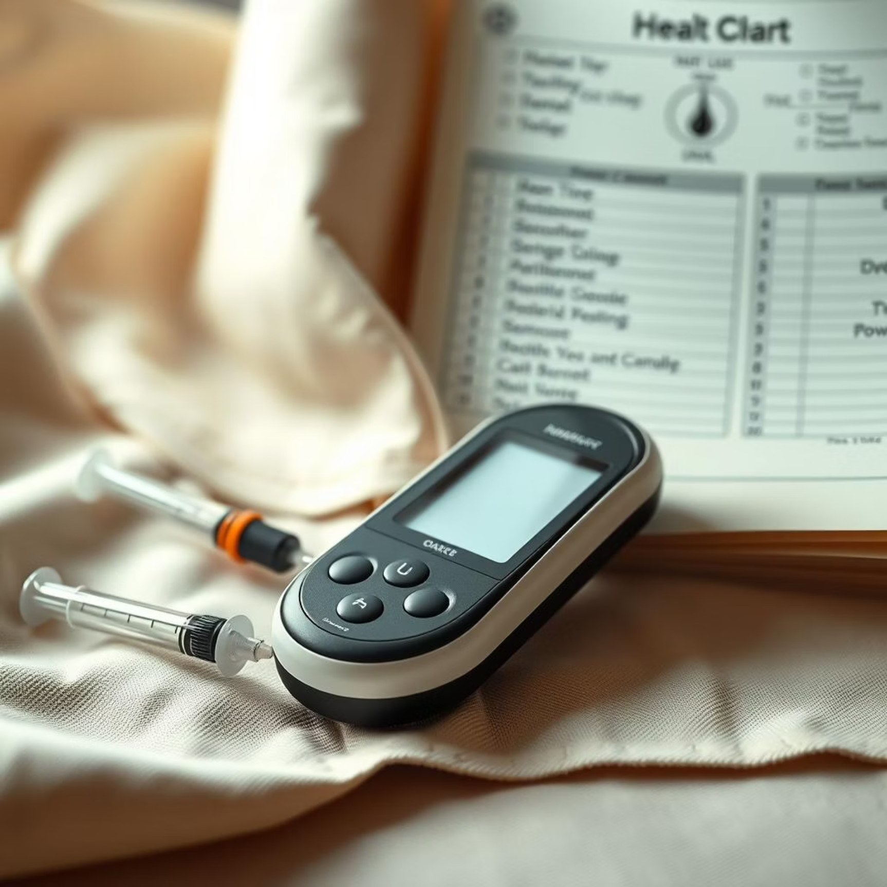
Introduction to Our Approach
The Silent Threat: Diabetes
Diabetes is a chronic, widespread disease affecting millions globally. Its prevalence continues to rise, leading to severe complications like heart disease, kidney failure, and blindness if undetected and unmanaged.
Early prediction and diagnosis are crucial for effective intervention, enabling patients to make lifestyle changes and receive timely medical care to prevent long-term damage.
Our objective is to leverage machine learning, specifically a Support Vector Machine (SVM), to build a robust model that can predict diabetes based on patient health data, offering a valuable tool for proactive healthcare.

Slide 3
Foundational Data
PIMA Diabetes Dataset
Our model is built upon the PIMA Diabetes Dataset, a widely used benchmark for diabetes prediction. This dataset contains medical diagnostic information for Pima Indian women, collected to predict the onset of diabetes based on diagnostic measurements.
Source
PIMA Diabetes Dataset (UCI Machine Learning Repository)
Dataset Size
768 samples
Target Variable
Outcome: 1 for diabetic, 0 for non-diabetic
Key Features:
Pregnancies
Glucose
Number of times pregnant
Plasma glucose concentration a 2 hours in an oral glucose tolerance test
BloodPressure
SkinThickness
Diastolic blood pressure (mm Hg)
Triceps skin fold thickness (mm)
Insulin
BMI
2-Hour serum insulin (mu U/ml)
Body mass index (weight in kg/(height in m)^2)
DiabetesPedigreeFunction
Age
Diabetes pedigree function
Age (years)

Slide 4





Our Process
Methodology Workflow
Our predictive modeling journey follows a structured workflow, ensuring data integrity, model efficacy, and reliable outcomes.
Data Collection & Loading
Gathering the PIMA Diabetes Dataset and preparing it for analysis.
Data Preprocessing
Cleaning, scaling, and handling missing values to optimize data quality.
Train-Test Split
Dividing the dataset into training and testing sets to evaluate model performance impartially.
Model Training (SVM)
Building the Support Vector Machine model with the prepared training data.
Model Evaluation
Assessing the trained model's accuracy and performance using various metrics.

Slide 5

The Predictive Engine
Support Vector Machine (SVM)
The Support Vector Machine (SVM) is a powerful supervised learning model used for classification and regression tasks. In classification, SVM aims to find the optimal hyperplane that best separates data points into different classes.
The "optimal" hyperplane is the one that has the largest margin between the closest training data points of any class, known as support vectors.
This maximal margin increases the model's generalization ability, reducing overfitting.
"SVMs are particularly effective in high-dimensional spaces and are versatile due to the use of kernel functions, which allow them to work well with non-linear data."

Slide 6
Preparing Our Data
Data Analysis & Preprocessing
Before feeding the data into our SVM model, thorough analysis and preprocessing steps were undertaken to ensure data quality and model readiness.
Initial Data Inspection: A preliminary review of the dataset revealed critical insights into feature distributions and potential anomalies. Statistical summaries provided a baseline understanding of each variable.
Handling Zero and Missing Values: Several features in the PIMA dataset, such as Blood Pressure, Glucose, and BMI, contained zero values that are biologically improbable (e.g., zero blood pressure). These were treated as missing values and imputed using the median strategy for each respective feature to maintain data integrity and prevent skewing the model.
Feature Scaling: Given the varying ranges of our features, StandardScaler was applied. This method standardizes features by removing the mean and scaling to unit variance, which is crucial for SVM performance as it relies on distance calculations.

Slide 7
Building and Validating
Model Training & Evaluation
With the data preprocessed, the next crucial steps involved training our SVM model and rigorously evaluating its performance.
Train-Test Split
SVM Classifier
The dataset was partitioned into training and testing sets to ensure an unbiased evaluation of the model's generalization capability.
A Support Vector Machine classifier was initialized with a linear kernel. The linear kernel is effective when data is linearly separable or when computational efficiency is a primary concern. It simplifies the decision boundary, reducing complexity.
Training Set: 80% of the data (614 samples) was used to train the SVM model.
Testing Set: The remaining 20% of the data (154 samples) was reserved for evaluating the trained model.
Evaluation Metrics
To comprehensively assess the model's performance, the following metrics were utilized:
Accuracy: The proportion of correctly classified instances.
Precision: The proportion of true positive predictions among all positive predictions.
Recall (Sensitivity): The proportion of true positive predictions among all actual positive instances.
F1-Score: The harmonic mean of precision and recall, providing a balanced measure.

Slide 8
Performance Snapshot
Key Results
Our SVM model demonstrated promising results in predicting diabetes on the PIMA dataset. Here's a summary of its performance:
0.77
TP: 42
TN: 97
FP: 13
Accuracy Score
True Positives
True Negatives
False Positives
Our model achieved an accuracy of 77% on the test set, indicating that it correctly predicted the outcome for 77 out of every 100 individuals.
Number of actual diabetic cases correctly identified.
Number of actual non-diabetic cases correctly identified.
Number of non-diabetic cases incorrectly predicted as diabetic.
FN: 2
False Negatives
Number of actual diabetic cases incorrectly predicted as non-diabetic (missed cases).
The low number of false negatives (FN) is particularly encouraging in a medical context, as missing a diabetic diagnosis can have significant health implications.

Slide 9
Evolving the Model
Improvements & Future Work
While our current model shows good performance, there are several avenues for further enhancement and exploration to maximize its utility and reliability.
Robust Missing Data Handling: Investigate more advanced imputation techniques (e.g., K-Nearest Neighbors imputation, regression imputation) or explore models that can inherently handle missing data.
Hyperparameter Tuning & Kernel Exploration: Implement GridSearchCV or RandomizedSearchCV to optimize SVM hyperparameters (e.g., C, gamma). Experiment with different kernel functions (e.g., RBF, polynomial) to capture non-linear relationships more effectively.
Additional Evaluation Metrics: Beyond accuracy, focus on Area Under the Receiver Operating Characteristic Curve (AU-ROC) and PR (Precision-Recall) curves, especially given potential class imbalance in medical datasets.
Explainability Methods: Integrate interpretability techniques like SHAP (SHapley Additive exPlanations) or LIME (Local Interpretable Model-agnostic Explanations) to provide medical insights into feature importance and model decisions.
Benchmarking with Other ML Models: Compare SVM performance against other classification algorithms such as Logistic Regression, Random Forest, Gradient Boosting, or Neural Networks to identify the optimal model for this specific problem.

Slide 10
Towards Healthier Futures
Conclusion & Impact
Summary of Achievements:
Potential Impact:
Successfully built and evaluated an SVM model for diabetes prediction using the PIMA dataset.
Early Intervention: Provides a valuable tool for healthcare providers to identify individuals at high risk of diabetes early, allowing for timely lifestyle interventions and medical management.
Achieved an accuracy of 77%, demonstrating the model's capability to distinguish between diabetic and non-diabetic individuals.
Resource Allocation: Helps in more efficient allocation of healthcare resources by focusing on preventive measures for at-risk populations.
Addressed critical data preprocessing steps, including handling missing values and feature scaling, which are vital for model performance.
Patient Empowerment: Equips individuals with critical health insights, fostering proactive engagement in their own well-being.
This project serves as a foundational step towards integrating predictive analytics into clinical practice, contributing to a future of more personalized and preventive healthcare.

